Slide 1
Business Case
San Francisco taxi cabs dataset analysis

Slide 2
The questions
CO2 EMISSION REDUCTION
NEXT PICKUP PREDICTION
CLUSTERING
Calculate the potential for yearly reduction on CO2 emissions, caused by the taxi cabs roaming without passengers.
Build a predictor for taxi drivers, predicting the next place a passenger will hail a cab.
Identify clusters of taxi cabs.
Notes:
I will present questions, challenges, implementation, and most important, the ideas I had but have not implemented them due to time and computation constraints.

Slide 3
CO2 EMISSION REDUCTION POTENTIAL
Assumptions
The taxi cab fleet is changing at the rate of 10% per month (from combustion engine-powered vehicles to electric vehicles).
the average passenger vehicle emits about 404 grams of CO2 per mile.
Notes:
As the raw dataset has 12~ million rows, I have decided to use the subset of it 1 mln rows. To accomplish this task I have made some preprocessing steps. As in the data I had waypoints for each waypoint I have added the trip Id identifier

Slide 4
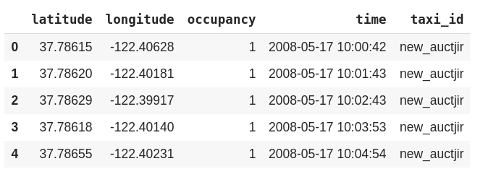
Raw data

Slide 5
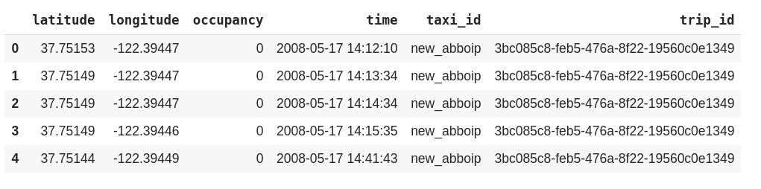
Processed data
Notes:
As in the data I had waypoints for each waypoint I have added the trip Id identifier. Please note that in this context trip is the trip with passenger, occupancy is 1, and the trips to find the passengers. After this step I have grouped data by trip ID and calculated distance, duration for each trip.

Slide 6
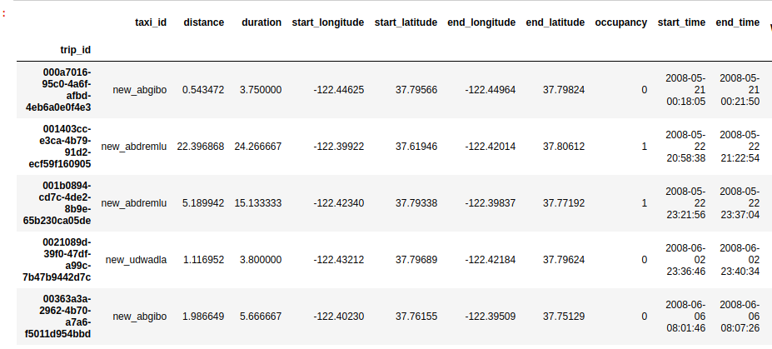
Aggregated data
Notes:
As in the data I had waypoints for each waypoint I have added the trip Id identifier. Please note that in this context trip is the trip with passenger, occupancy is 1, and the trips to find the passengers. After this step I have grouped data by trip ID and calculated distance, duration for each trip.

Slide 7
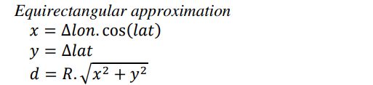
Calculation of Geographical Distance
Notes:
As for Geographical distance, Of all methods explored Equi-rectangular approximation is preferred for faster system performance.

Slide 8
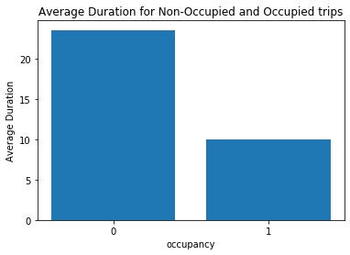
Statistics on duration and distance of free rides vs with passenger rides
Notes:
We have calculated yearly_replacment_count based on the monthly reduction, (385) and as the potential means the maximum number of co2 emission we can reduce, subtracted the taxis whose emission of co2 in free rides was the maximum.

Slide 9
Missing values
No missing values or invalid observations were detected

Slide 10
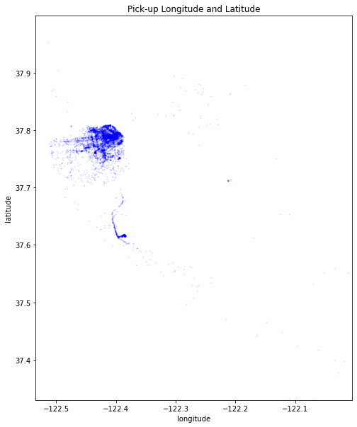

Slide 11
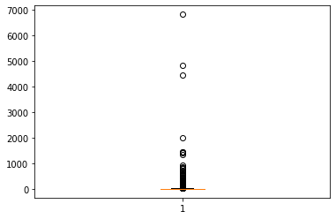
The boxplot of the duration

Slide 12
Feature addition
Hour
Day
Weekday
Speed
hour_bins = [-1, 5, 7, 10, 16, 21, 23]
bin_names = ['late_night', 'morning', 'morning_peak', 'afternoon', 'evening', 'night']

Slide 13
One more feature... region clusters

Slide 14
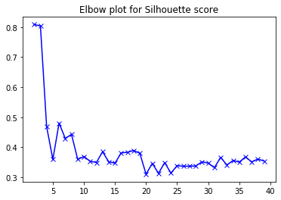
K means clustering for longitude and latitude
Silhouette score for different values of K
Silhouette score is remaining the same after k = 35
Notes:
We can choose 35 clusters for our task, since silhouette score is remaining the same after that cluster

Slide 15
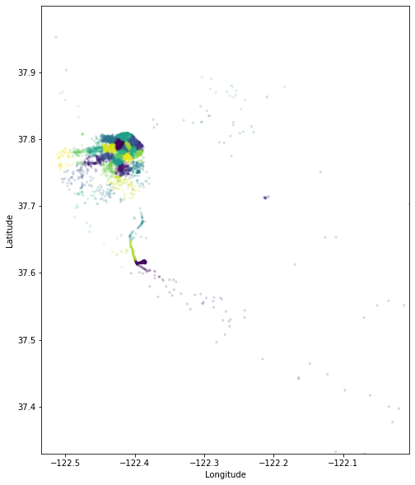
Map based on clusters
Notes:
We can choose 35 clusters for our task, since silhouette score is remaining the same after that cluster

Slide 16
Opportunities of external data sources
Weather data
Airport trip flag
etc.

Slide 17
Modeling
Multivariate XgBoost
Mean squared error = 0.000333
Multivariate Linear Regression
Mean squared error = 0.0012

Slide 18
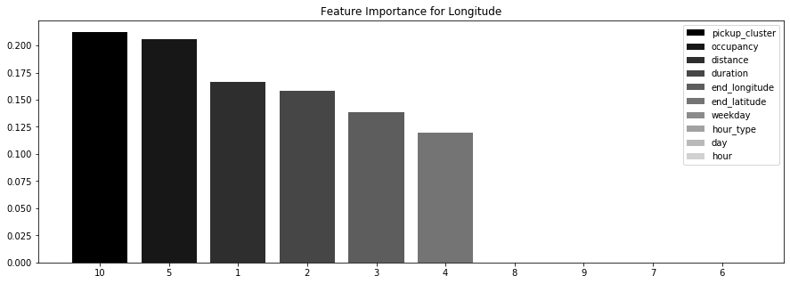

Slide 19
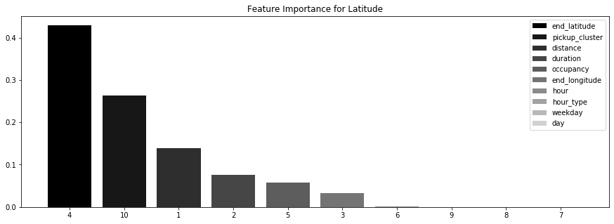

Slide 20
Pitfalls of the use of the model
Independent variable
Showing concrete location
Smoothing time series
We are forcing model to learn to go to the pick up locations even when taxis were wrongmost of the time in their search
We can show the demand on the region instead of showing the concrete location so as taxis can decide to which region they want to ride.
We have not used time series data potential and characteristics

Slide 21
Solution
Predicting demand given the region and the time bins

Slide 22
Implementation

Slide 23
Time Series Prediction
Given a region and a 10 min interval, we have to predict pickups.
(a): How to break up the San Francisco into regions?
(b): Every region of San Francisco has to be broken up into 10 min interval.
We have used K means clustering to break up San francisco into regions
We already know, about the pickup at time ‘t’, we will predict the pickup at time ‘t+1’ in the same region. Hence, this problem can be thought of as a Time Series Prediction problem. It is a special case of regression problems. In short, we will use the data at time ‘t’ to predict for time ‘t+1’.

Slide 24
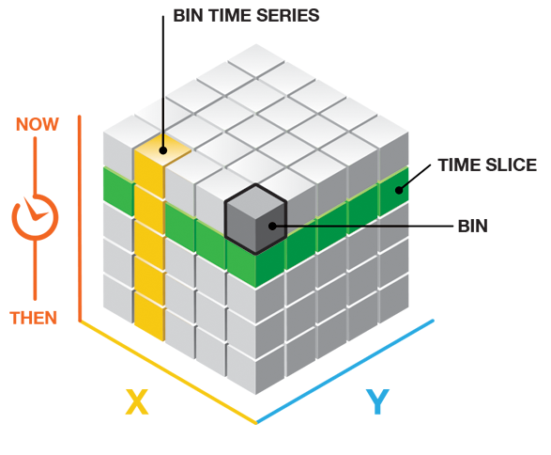

Slide 25
Thanks!

